Slide 1
Fox Hills Elementary School
“FOX FOCUS” Lesson Plan

Slide 2
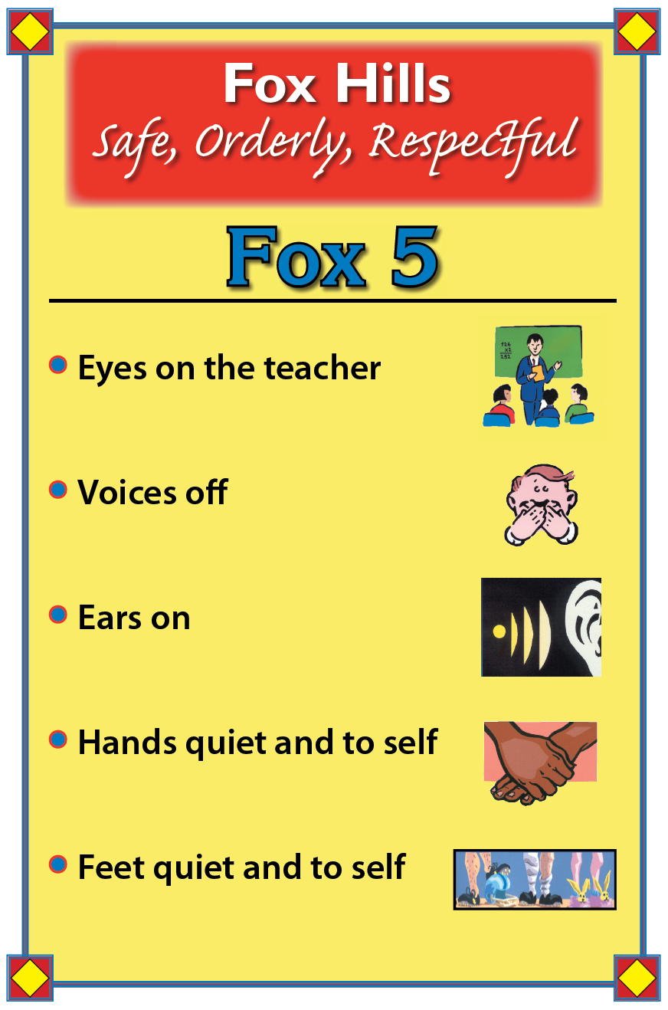
Let’s practice!

Slide 3
Lesson Objectives:
When you leave today, you will:
Be able to state the Fox Focus expectations
Be able to explain what the following words
mean:
SAFE RESPECTFUL RESPONSIBLE
Be able to give examples of safe,
respectful, and responsible behaviors
Be able to say, sign, or show the Fox Focus
expectations

Slide 4
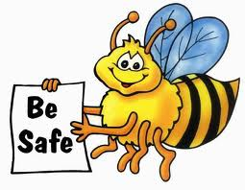
BE SAFE

Slide 5
SAFE is . . .
Being free from harm or risk
(the possibility of getting hurt)

Slide 6
6 Guidelines for Feeling and Being Safe
Stick to safety rules at school, on the bus, on the street, at home, and in sports and other activities. Stay away from dangerous things like matches, fireworks, and knives unless an adult is there to help.
Ask a trusted adult to help you if you see something dangerous or don’t feel safe.
Feel safe inside by following safety rules, being careful, knowing what to do in an emergency, and making safe choices.
Encourage your friends to be safe, too. Stick to what you know is right, even if friends tease you or try to change your mind.
Trust your instinct. Listen to the voice inside you that says something isn’t right.
Yell for help if you’re in danger.

Slide 7
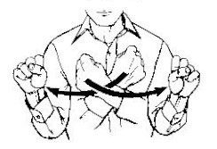
Let’s Sign the Fox Focus
SAFE

Slide 8
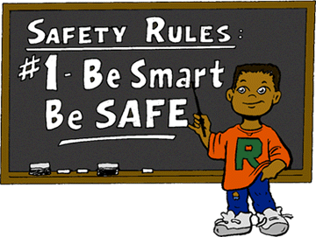

Slide 9
RESPECTFUL

Slide 10
RESPECTFUL is . . .
Showing behavior that considers
and values the thoughts, feelings,
and rites of others

Slide 11
TYPES OF RESPECT
Respect yourself
Respect towards other people
Respect differences
Use good manners
Respect property
Respect nature and other living things
Respect laws, beliefs, and customs

Slide 12
RESPECTFUL is . . .

Slide 13
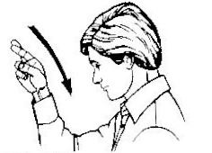
Let’s Sign the Fox Focus
RESPECTFUL

Slide 14
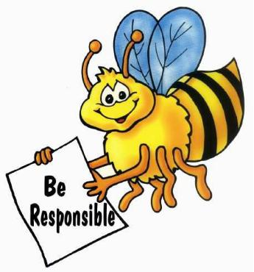
RESPONSIBLE

Slide 15
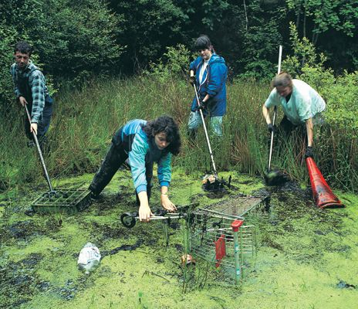
RESPONSIBLE
Doing what you promise to do
Being dependable and trustworthy

Slide 16
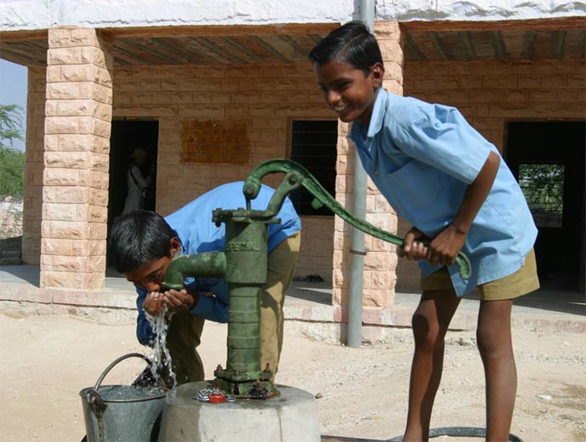
RESPONSIBLE
Responsible for ME.
Responsible to OTHERS.
Responsible at SCHOOL.

Slide 17
6 Ways to Make Responsible Choices
Consider what might happen – think before you act.
Help yourself be responsible by getting and staying organized.
Obey rules and laws in your home, school, and community.
Ignore bad ideas that pop into your head. Change what you’re doing or think about something good instead.
Choose the choice that’s best for you and for others- the one that feels right inside.
Earn people’s trust by showing that they can count on you.

Slide 18
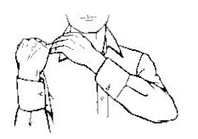
Let’s Sign the Fox Focus
RESPONSIBLE

Slide 19
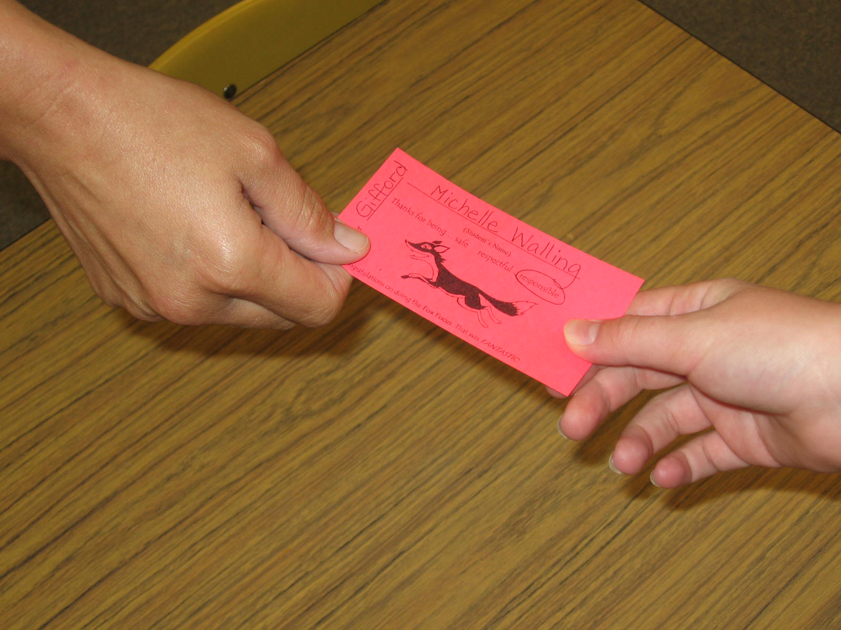
FOX FOCUS TICKETS

Slide 20
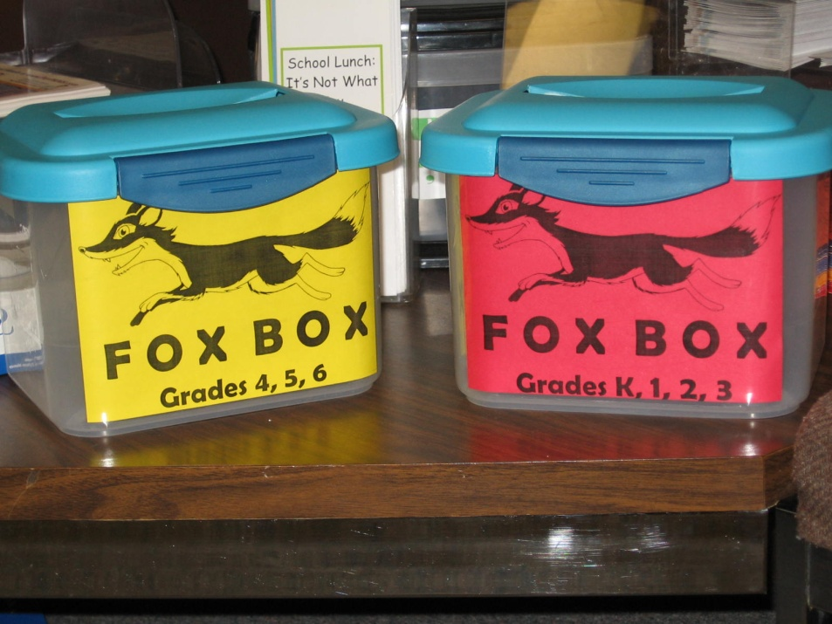
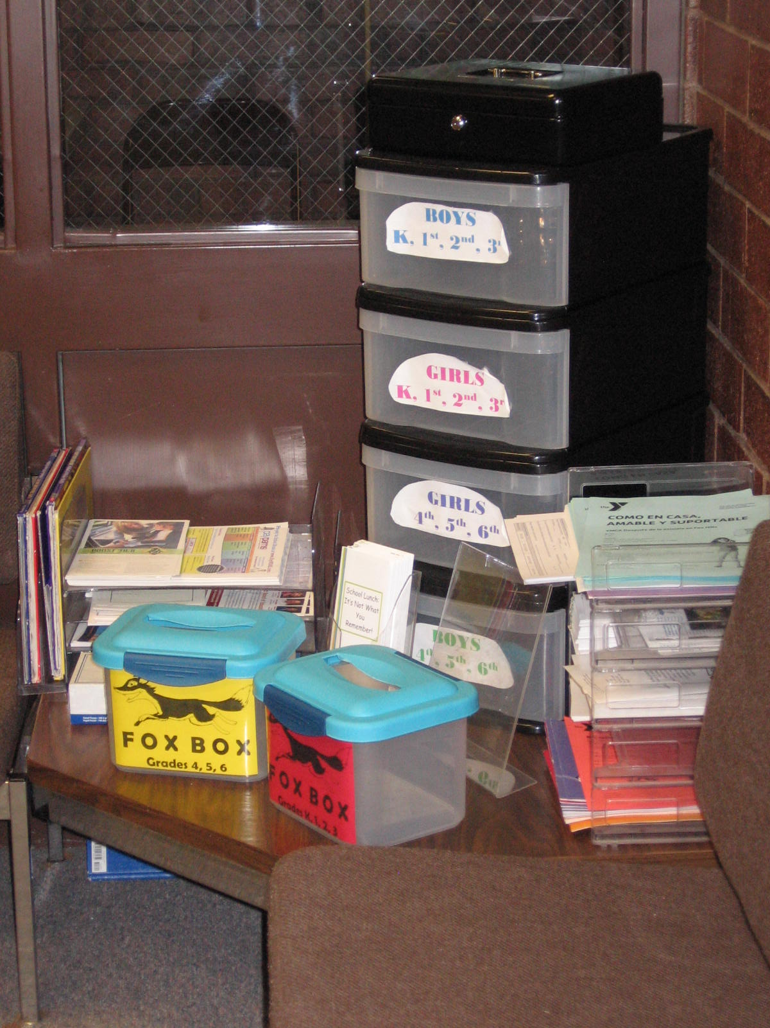
FOX FOCUS TICKETS

Slide 21
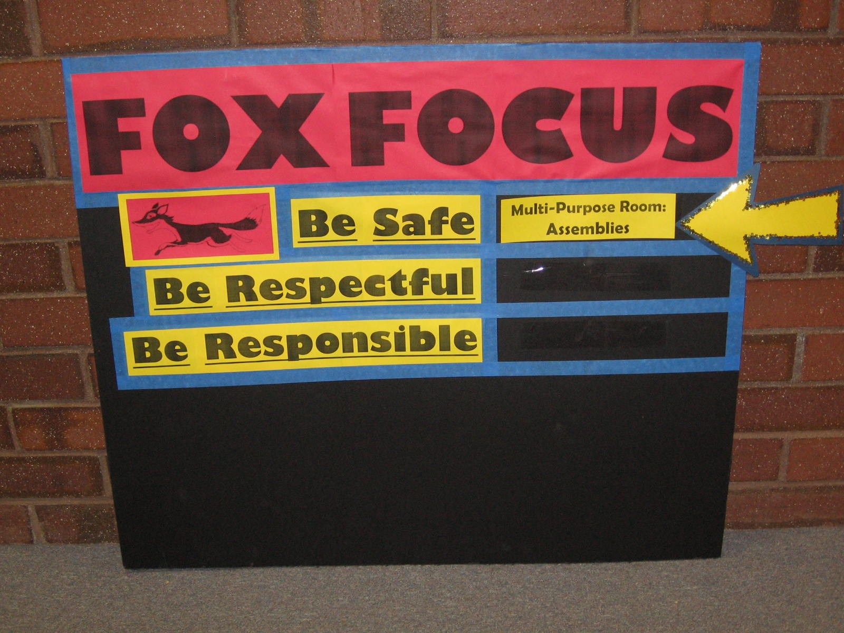
Weekly Fox Focus Review

Slide 22
Let’s Review: FOX FOCUS
I know the three Fox Focus expectations.
I know what “SAFE” means.
I know what “RESPECTFUL” means.
I know what “RESPONSIBLE” means.
I can give an example of a safe behavior at school.
I can give an example of a respectful behavior at school.
I can give an example of a responsible behavior at school.
I can tell you the three Fox Focus expectations using American Sign Language.
I can show safe, respectful, and responsible behavior in any location at Fox Hills.

Slide 23
Quiz:
SIGN IT . . .
BE RESPONSIBLE
SAY IT . . .

Slide 24
Quiz:
SIGN IT . . .
BE SAFE
SAY IT . . .

Slide 25
Quiz:
SIGN IT . . .
BE RESPECTFUL
SAY IT . . .

Slide 26
Homework:
Go home and teach at least ONE person in your home something you learned today about the Fox Hills Focus.

Slide 27
Bibliography
Stick Up for Yourself, Gershen Kaufman & Lev Raphael, Free Spirit Publishing, Inc., Minneapolis, Minnesota, 1990.
More Activities that Teach, Tom Jackson, Red Rock Publishing, Cedar City, Utah, 1995.
What Do You Stand For?, Barbara A. Lewis, Free Spirit Publishing, Inc., Minneapolis, Minnesota, 1990.
Violence Prevention Skills, Ruth Weltmann Begun & Frank J. Huml, The Center for Applied Research in Education, Cleveland, Ohio, 1999.

